Slide 1


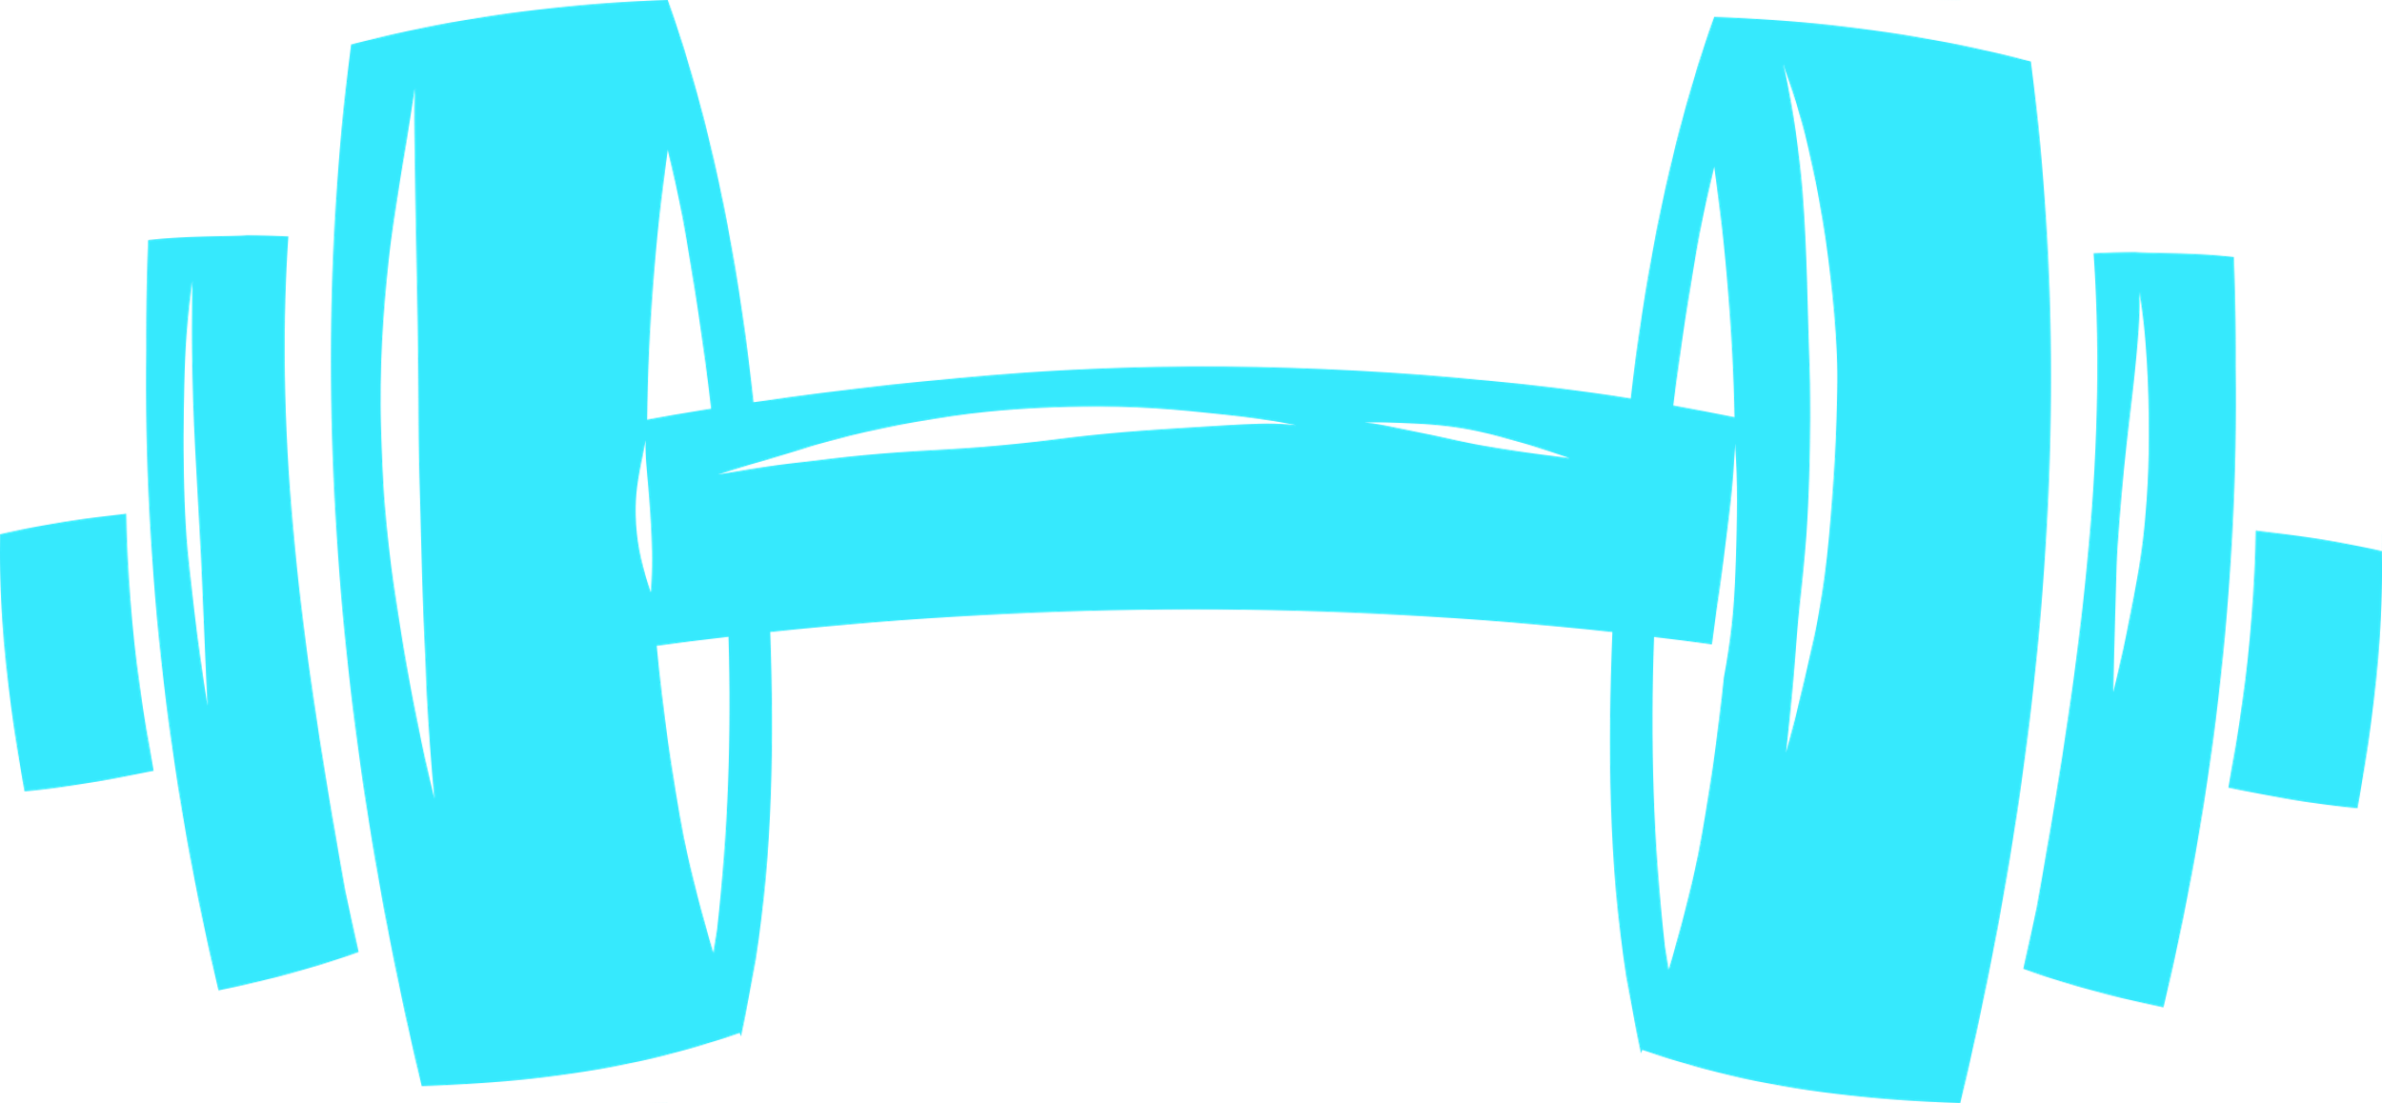
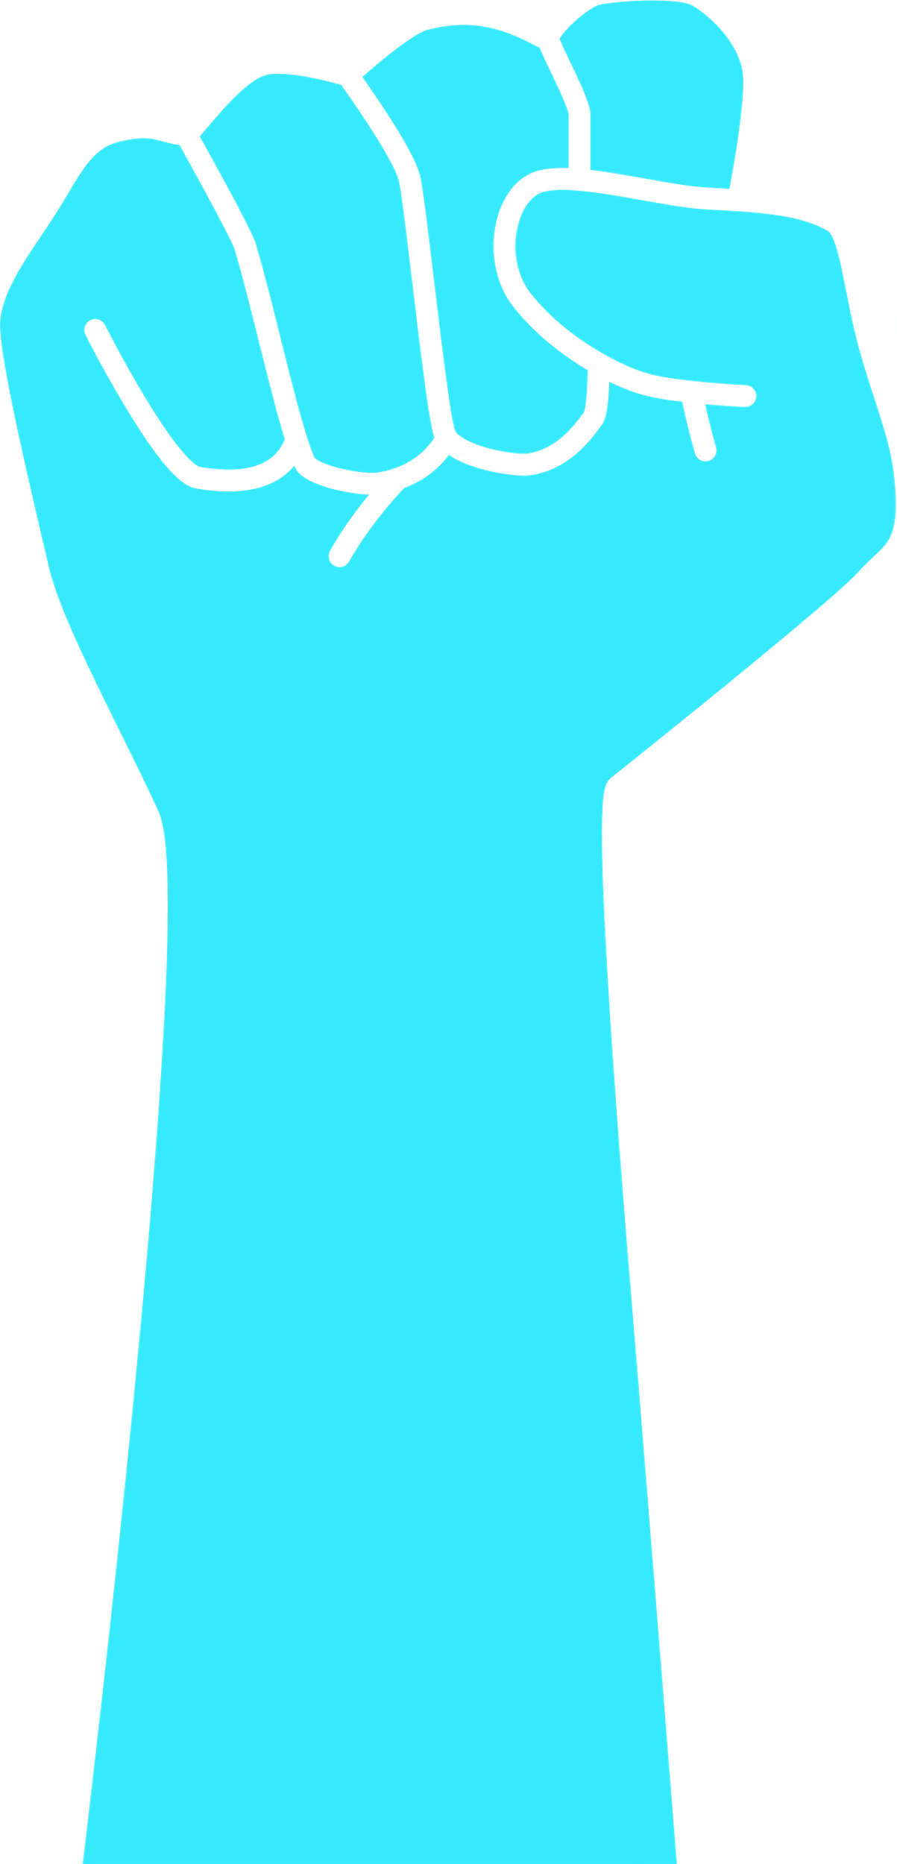

BodyTrack
Real-Time Posture Evaluation Using Biomechanics & Machine Learning
Final Project ID: 25-2-D-4
Presented by: Elad Krauz and Uri Ziv
Supervisors: Mrs. Elena Kramer and Dr. Dan Lemberg
Department of Software Engineering, Braude College of Engineering
1

Slide 2
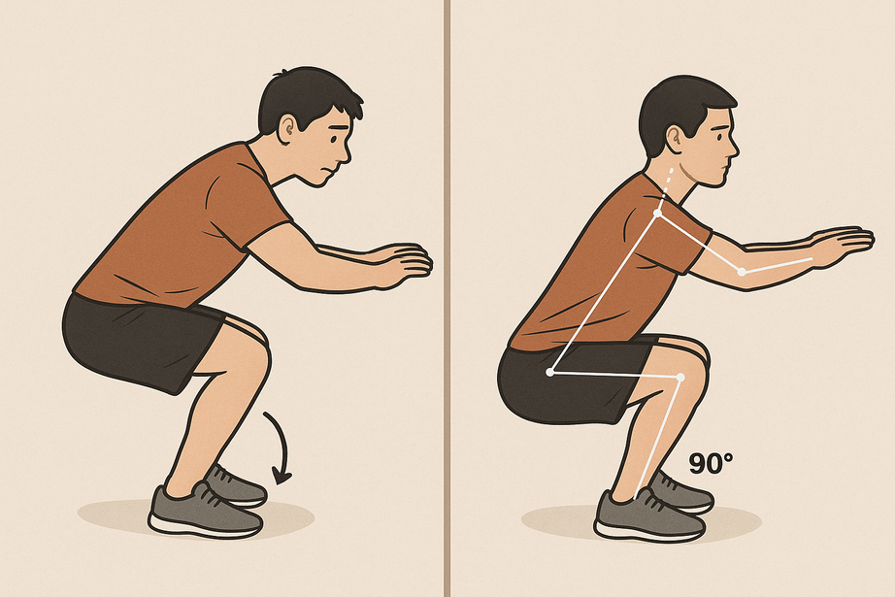


The Problem: Unsafe Training Without Supervision
Strength training is more popular than ever. But while access to equipment has grown, access to expert supervision hasn’t.
Most people train alone, without knowing if their posture is right - and mistakes go unnoticed.
Incorrect posture during exercises can lead to:
Muscle imbalances that affect progress
Joint stress and long-term injuries
Ineffective workouts with little improvement
Current fitness apps do not offer real-time posture correction.
Most users only realize their mistakes when it’s too late - after pain or injury occurs.
2

Slide 3
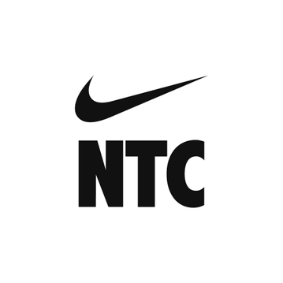

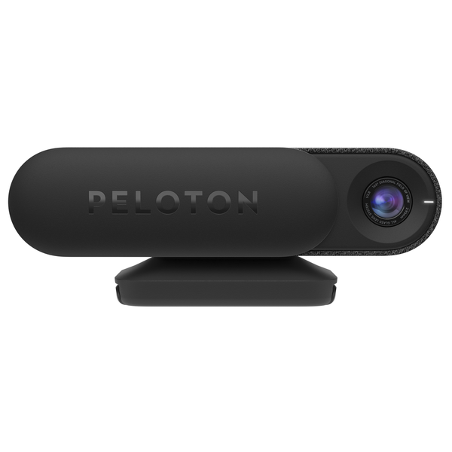
What Exists Today – and Why It’s Not Enough
There are many fitness apps and smart devices on the market today. None of them provide real-time posture correction using only a smartphone.
Existing solutions include:
Training apps like Nike Training Club or Freeletics – offer workouts, but no form tracking
Devices like Mirror or Peloton Guide – provide camera-based feedback, but are expensive and require special hardware
Apps like Kaia Health – focus on therapy, not full-body strength exercises
These tools are useful, but they don’t solve the core problem: helping people correct form in real time, during strength exercises, without buying new equipment.
3

Slide 4
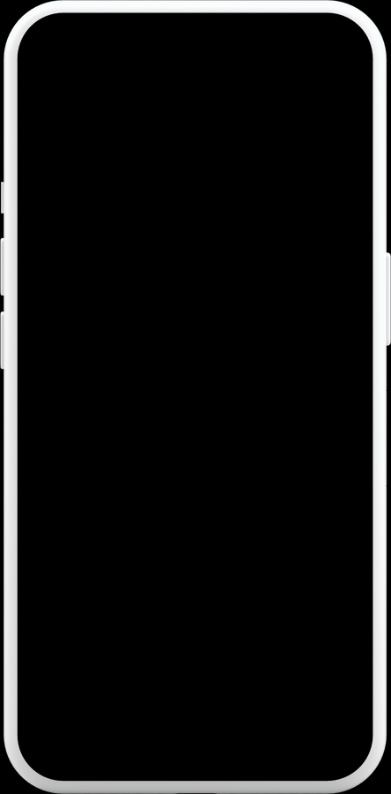
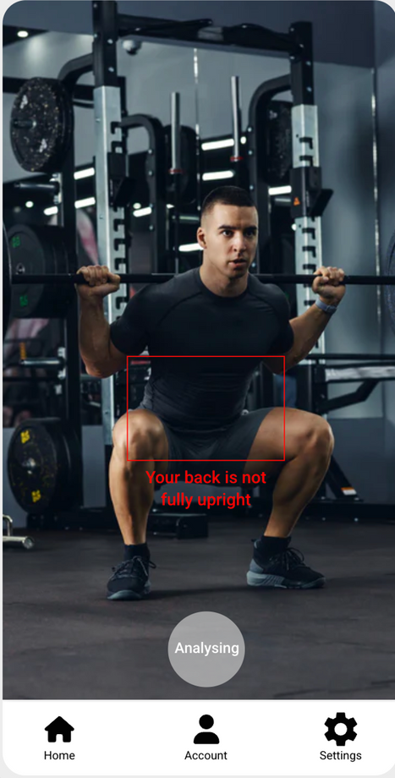
Our Goal:
Real-Time Posture Correction for Everyone
BodyTrack is an Android-based app that helps users improve their exercise technique — safely, effectively, and independently.
Our mission:
Use only the smartphone’s camera — no external hardware needed
Make smart coaching accessible to anyone, anywhere
Deliver real-time feedback on posture and joint alignment
We aim to reduce injuries, improve performance, and help users train confidently — just like having a personal coach in your pocket.
4

Slide 5
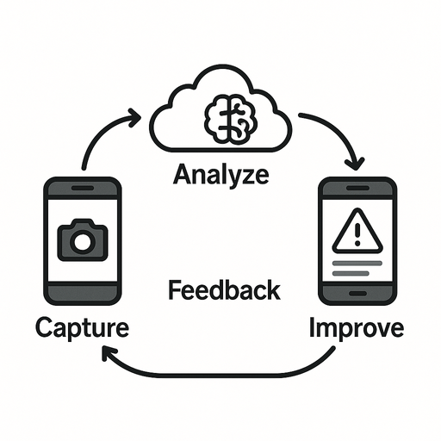

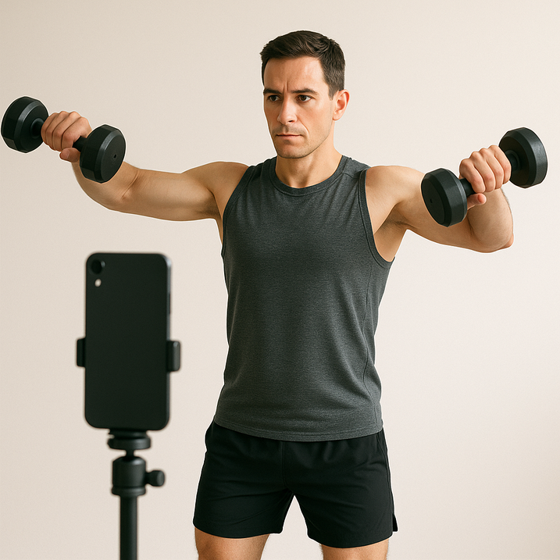
How BodyTrack Works – The Concept
BodyTrack is a real-time posture analysis system built as a mobile–cloud solution.
Here’s what it does:
1
Captures live video from the phone’s camera
2
Sends frames to a remote server for processing
3
Server runs pose estimation and biomechanical analysis
4
If an error is found, the app gives instant feedback — visually and through audio
5
At the end, a summary report helps the user improve over time
The app acts as a virtual personal coach, guiding the user during strength exercises like squats, curls, and shoulder raises.
5

Slide 6
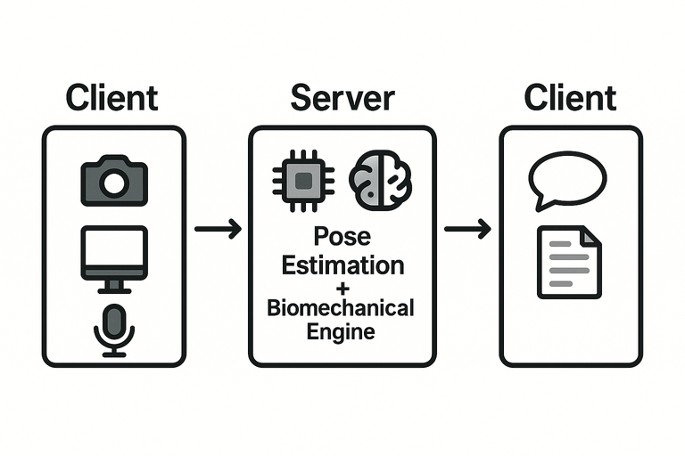
System Architecture:
Lightweight Client, Smart Server
BodyTrack is built as a modular client–server system:
The mobile app (client) handles the camera, UI, and displaying feedback
The server (backend) handles all pose analysis and biomechanical evaluation
This design keeps the app fast and responsive, while the server performs the heavy computation.
Architecture layers:
Input Layer (Client): captures video frames
Analysis Layer (Server): pose detection, angle analysis, error detection
Presentation Layer (Client): displays feedback and session summary
This separation ensures real-time feedback and easy future updates.
6

Slide 7
How Data Moves: From Camera to Correction
User starts session and selects an exercise
The camera captures frames of the user during movement
The server performs pose estimation to detect joints
Frames are sent to the cloud server
After the session, a summary report is generated
If errors are found, feedback is sent back immediately
Posture is compared to biomechanical reference models
Joint angles and movement phases are calculated
This flow happens continuously during training — allowing live corrections.
7

Slide 8
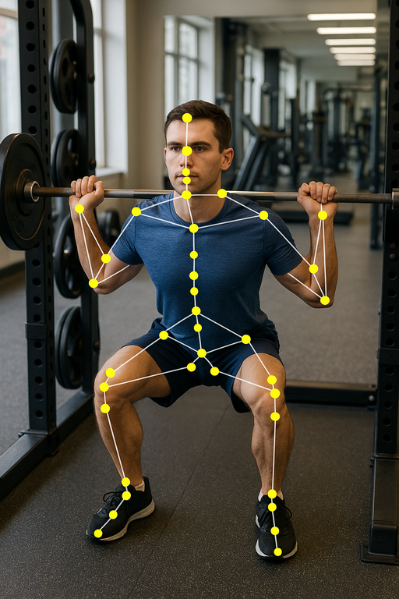
Pose Estimation – Powered by MediaPipe
BodyTrack uses MediaPipe Pose, a real-time pose estimation framework developed by Google.
Detects 33 body landmarks (e.g., shoulders, elbows, hips, knees, ankles)
Uses a two-stage pipeline:
→ First, detects the person’s region of interest
→ Then uses a CNN-based regression model to estimate
joint coordinates
Outputs (x, y) position + visibility confidence per joint
Provides smooth, stable tracking using built-in filtering
Runs in the Python backend, enabilng efficient cloud-based processing
Supports both 2D and approximate 3D (Z-Axis) tracking
This pose data is the foundation for calculating angles and detecting posture errors in real time.
8

Slide 9
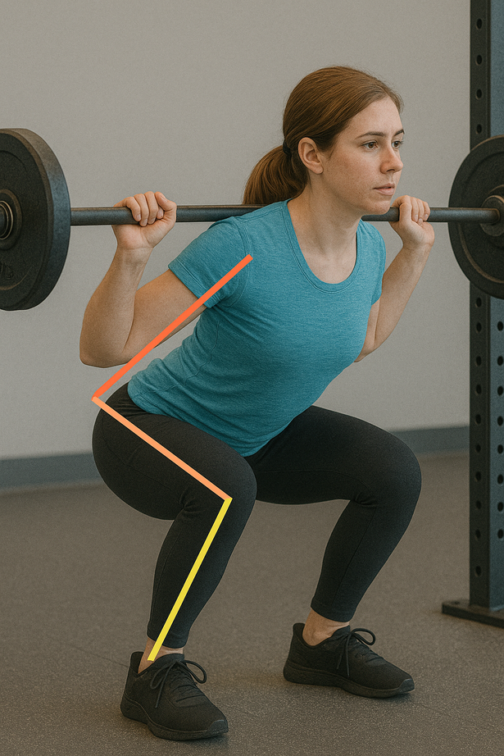

Understanding Movement – Joint Angles and Biomechanical Rules
After pose estimation, BodyTrack performs biomechanical analysis to evaluate form.
Calculates joint angles using vector geometry (e.g., knee, elbow, back)
Detects movement phases (e.g., descent, bottom, ascent)
Compares posture to exercise-specific reference models
Implemented using NumPy and vector math in the Python backend
Includes tolerance thresholds to allow small natural variations
For example: In a squat, BodyTrack checks that
→ Knee flexion reaches at least 100°
→ Back tilt stays under 45°
→ Both knees move symmetrically (≤10° difference)
9

Slide 10

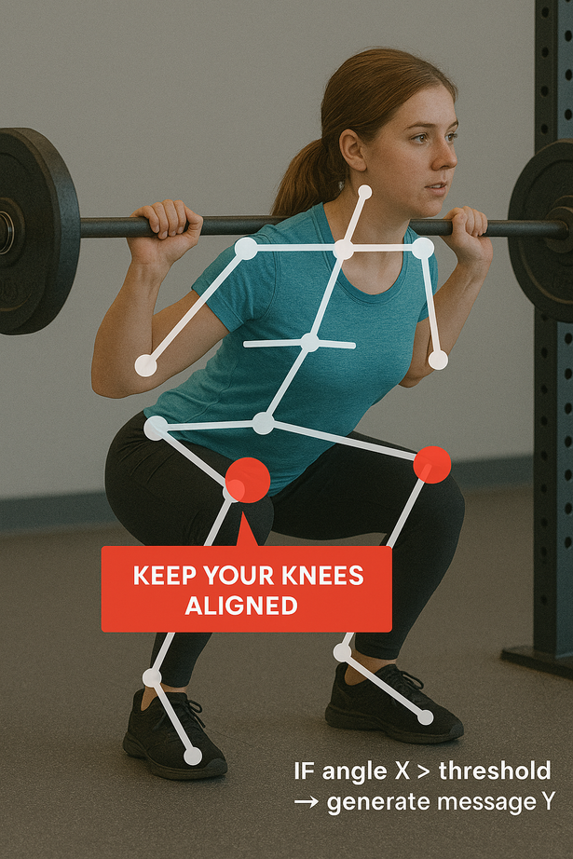
Detecting Posture Errors and Giving Real-Time Feedback
After analyzing joint angles and movement phases, BodyTrack uses defined biomechanical rules to detect mistakes.
Each exercise includes a set of error conditions (e.g., insufficient depth, asymmetry, unstable movement)
Errors are identified the moment they happen — frame by frame
These are implemented as decision trees that compare real-time values to thresholds
The system sends audio cues, visual overlays, or both, to correct the user instantly
Feedback is clear, timely, and designed to guide correction during the rep, not after.
10

Slide 11
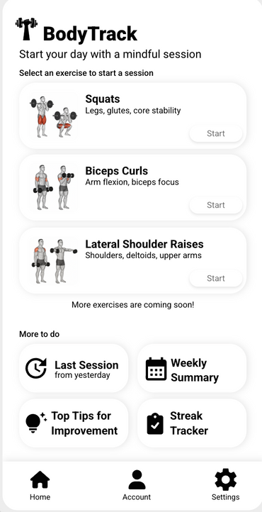
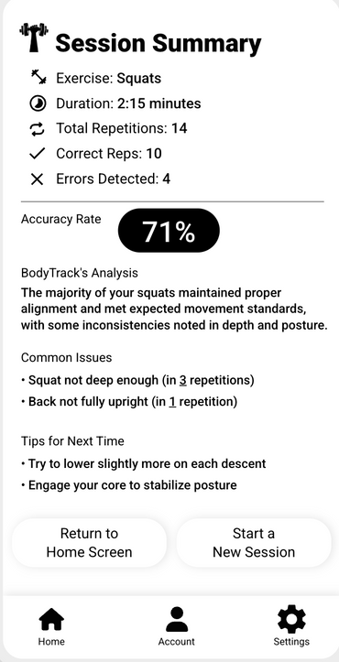
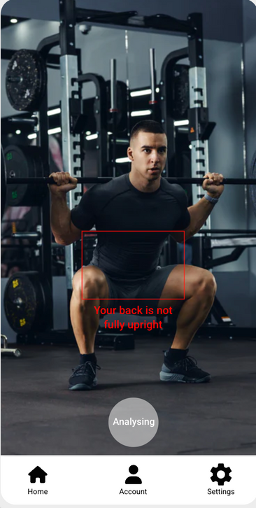
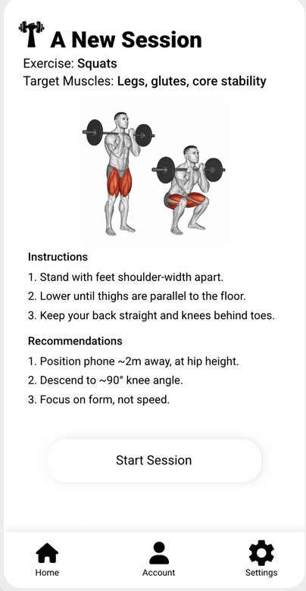
Designed for Clarity – The BodyTrack User Interface
BodyTrack was designed to feel like a real coach — without distractions
or complexity.
Minimal setup: Select exercise, position the phone, start training
Live visual overlays: Pose skeleton + joint highlights
Real-time cues: Audio alerts when posture errors are detected
Session summary: After each set – rep count, detected issues, improvement tips
The UI is developed in Kotlin, using Jetpack Compose and CameraX
for real-time camera integration.
Clear design = better focus, better training.
11

Slide 12
From Concept to Code – Technologies and Implementation
Mobile App - Client Side
Built with Kotlin in Android Studio
UI with Jetpack Compose
Camera input via CameraX API
Feedback via Android Text-to-Speech (TTS)
Displays real-time alerts from the server
Cloud Server - Backend
Developed using Python (Flask or FastAPI)
MediaPipe Pose for joint detection
NumPy + vector math for joint angle calcs
Custom logic engine for posture validation
Returns feedback in real time via JSON
Architecture
Client-server model: All analysis and models run remotely
HTTPS communication for speed and security
System designed to be modular and expandable
12

Slide 13
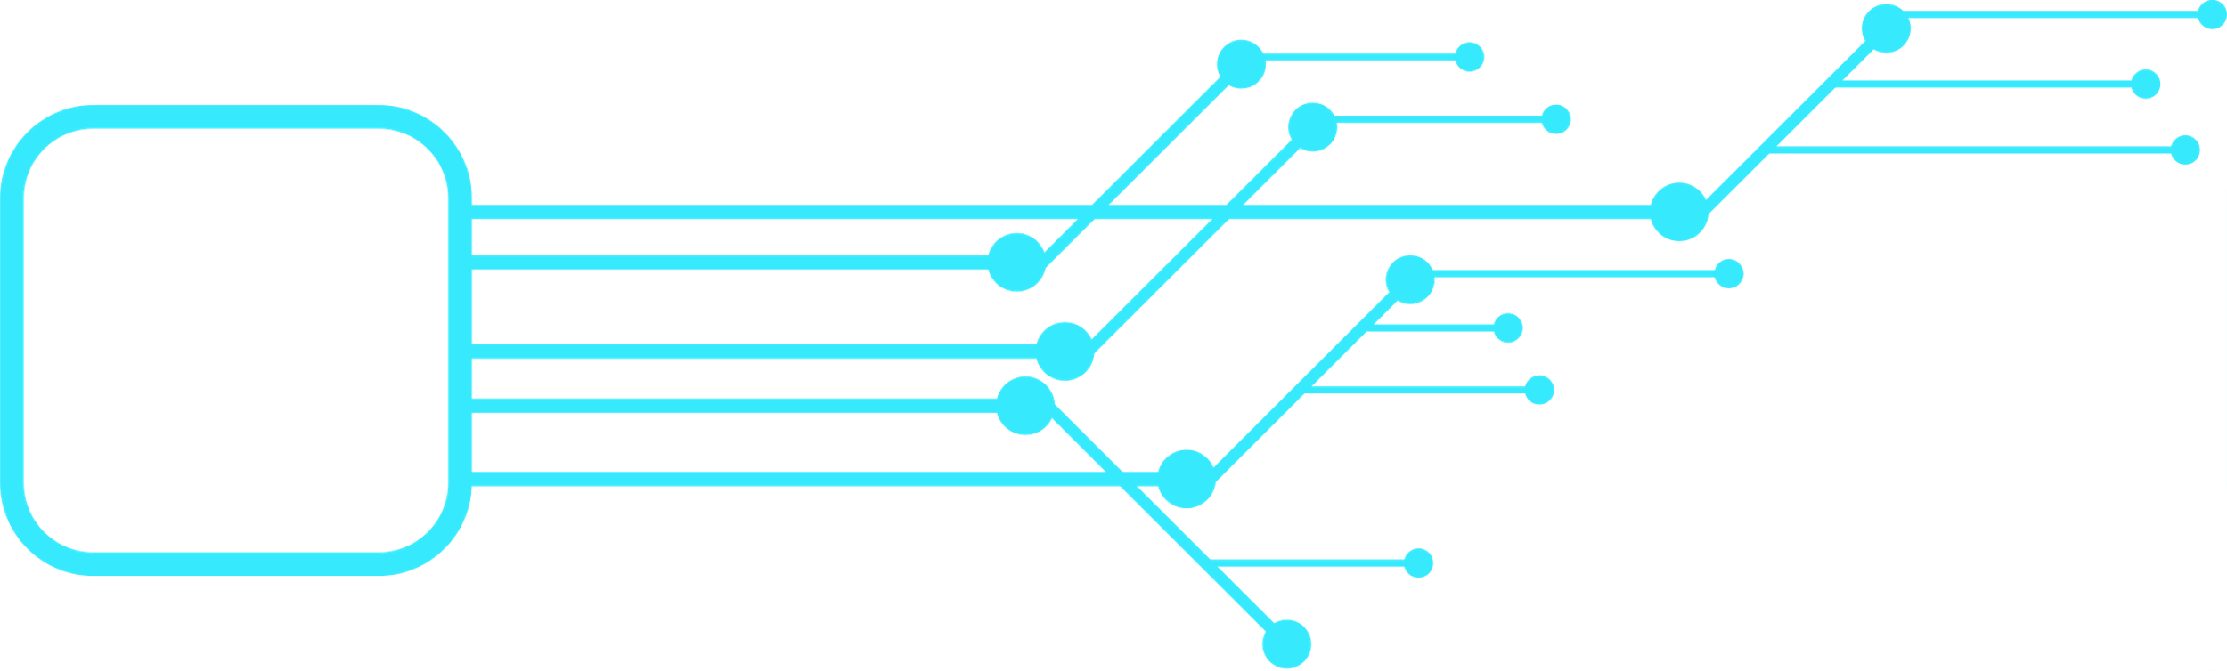
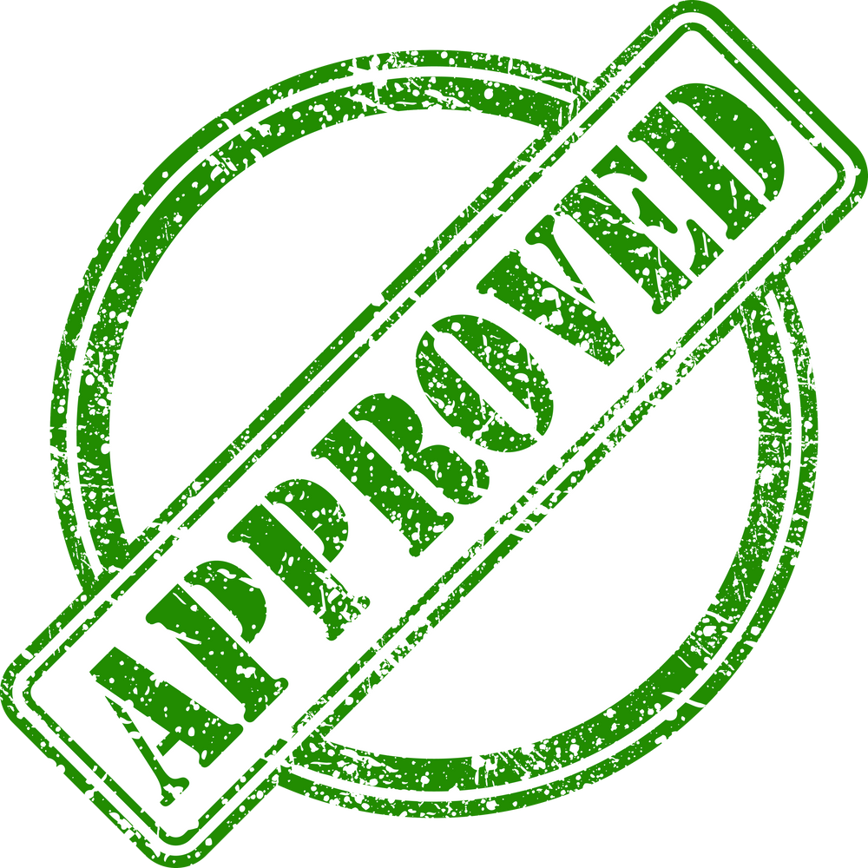
Planned Verification – Accuracy & Responsiveness
We structured a detailed verification plan to evaluate accuracy, timing, and usability across all components. Once implementation is complete, we will test:
1) Camera & Input Handling
Real-time frame capture using CameraX
Performance on mid-range Android devices
2) Pose Estimation & Joint Angles
MediaPipe landmark accuracy
Angle calculations tested with known postures
3) Feedback Responsiveness
Measure delay between motion and feedback
Target response time: < 1 second
4) Summary Reports
Accuracy of rep counting and error classification
Compare against expert evaluations
5) User Experience
Test under different lighting and positioning
Handle poor visibility, signal loss, and app flow
13

Slide 14


Strengths and Challenges of BodyTrack
Advantages
Limitations
Real-time posture feedback using only a smartphone – no external hardware
Combines pose estimation + biomechanics + audio coaching
Modular and scalable: easy to add new exercises
Encourages safe and independent training
Lightweight, works on mid-range Android devices
Requires full-body visibility and decent lighting
Real-time feedback depends on internet connection
Feedback logic currently based on rule-based thresholds
Supports only a limited set of exercises in the current phase
Verification and model tuning are still pending
14

Slide 15



Thank You!
15

